Slide 1
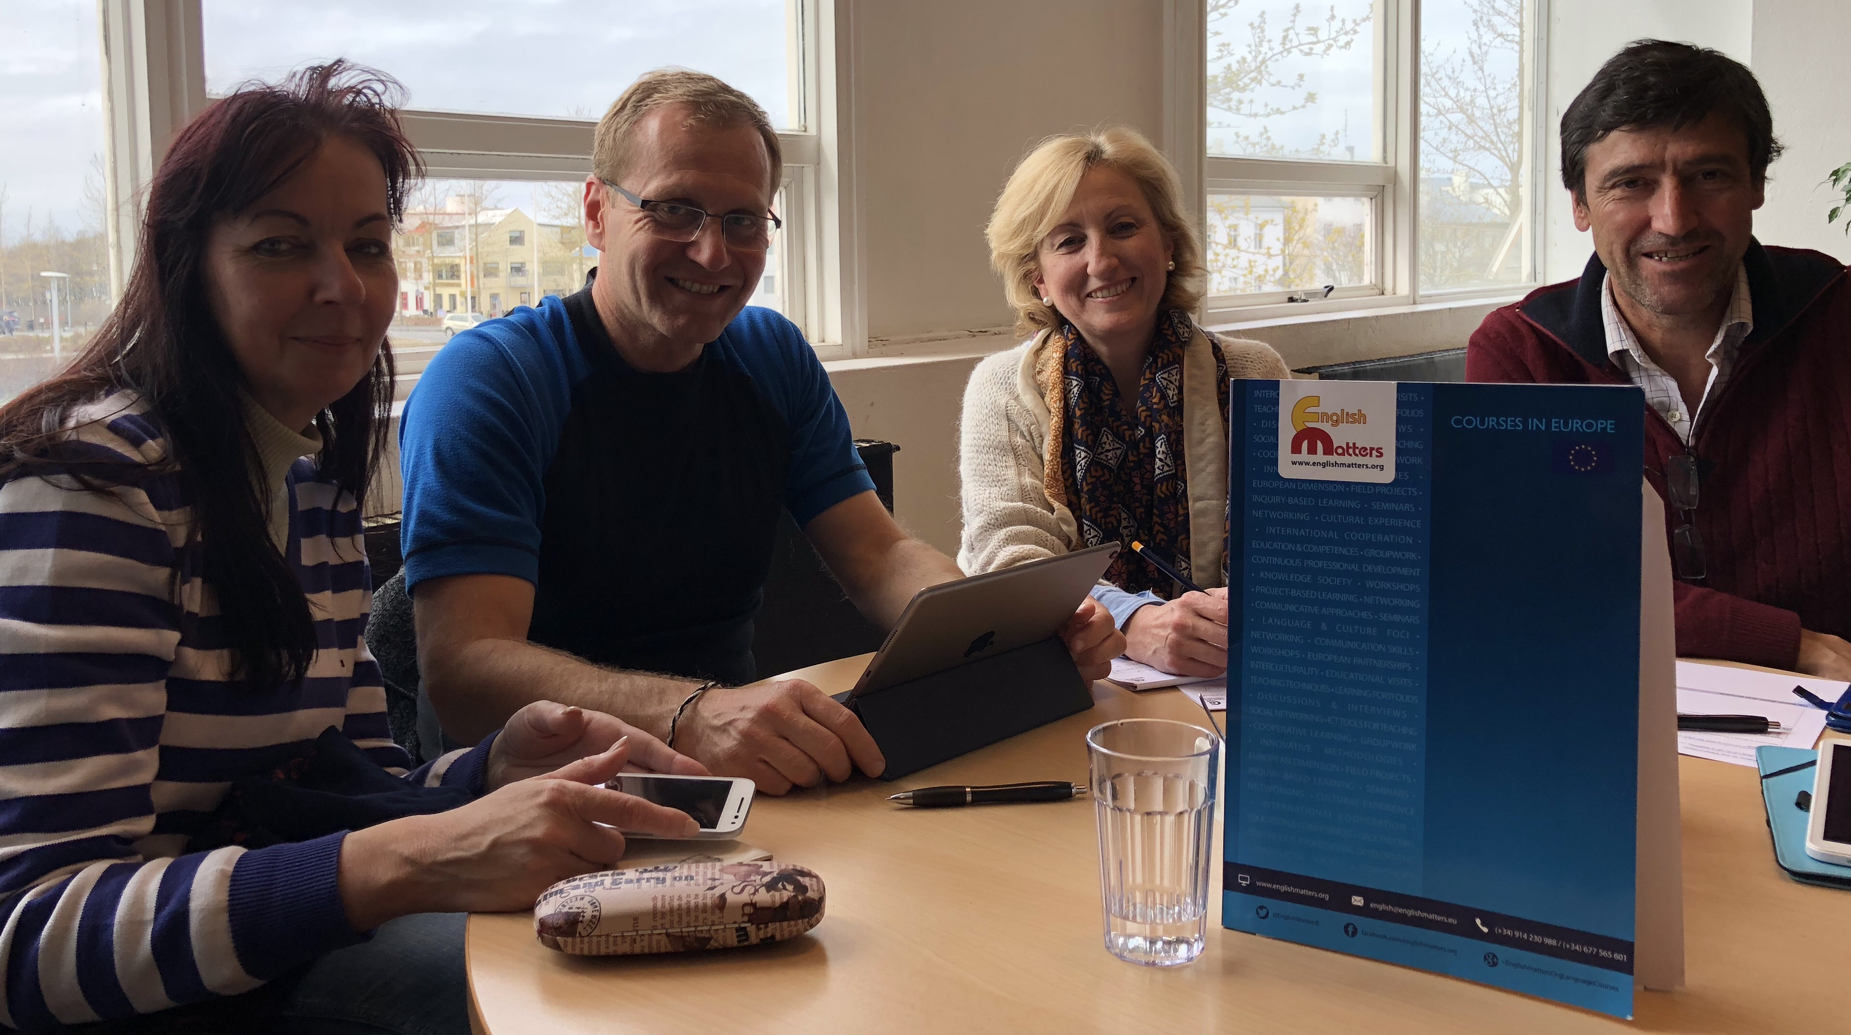
Structure study visit to schools/institutes & training seminar in ICELAND 22. 4. – 28. 4. 2018
Renata Lavkova , Slovakia
Martin Tobias, Czech Republic
Maria Angeles Verdejo, Spain
Antonio Jimenez Uceda, Spain

Slide 2
Learning about schools & Education System
THE ICELANDIC SCHOOL SYSTEM IS VERY SIMILAR TO THE SYSTEMS OF THE EUROPEAN COUNTRIES
FUNDAMENTAL PILLARS OF SCHOOL SYSTEM IN THE ICELAND ARE VERY INSPIRATIVE AND ACHIEVING THE TRADITIONS OF YOUNG ICELAND DEMOCRACY, INDEPENDENCE
INTEREST IN THE STUDY OF TECHNICAL FIELDS IN VOCATIONAL SCHOOLS IS VERY POSITIVE, BASED ON COOPERATION BETWEEN COMPANIES AND SCHOOLS, SUPPORTED BY THE GOVERNMENT
STUDENTS ARE VERY ACTIVE IN THEIR SCHOOLS, HAVE A LARGE SUPPORT FROM THE TEACHERS, PARENTS AND OTHER COMPONENTS OF THE EDUCATION SYSTEM
THE ICELANDIC SCHOOL SYSTEM IS VERY POSITIVE AND FOCUSES ON NATURAL LIFE, NATIONAL ECONOMY AND TRADITIONS
Literacy – Sustainability - Health and welfare –
Democracy and human rights – Equality – Creativity
Handmade – Headmade - Homemade

Slide 3
THE MOST REPRESENTATIVE PICTURES OF YOUR EXPERIENCE
NATURE
GLAZIERS
VOLCANOS
NORTHERN LIGHT
HISTORY
THE FIRST SETTLEMENTS
THE VIKINGS
INDEPENDENCE
LIFE IN ICELAND
HANDMADE PRODUCTS, NATIONAL PRODUCTS
SOCIALIZING IN SWIMMING POOLS
ARCHITECTURES
PICTURES OF PRICES

Slide 4
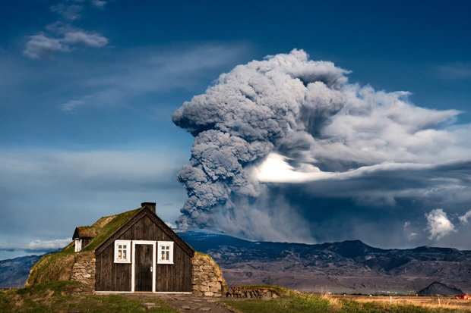
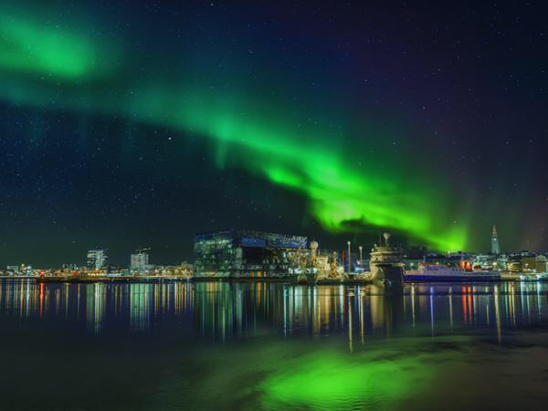
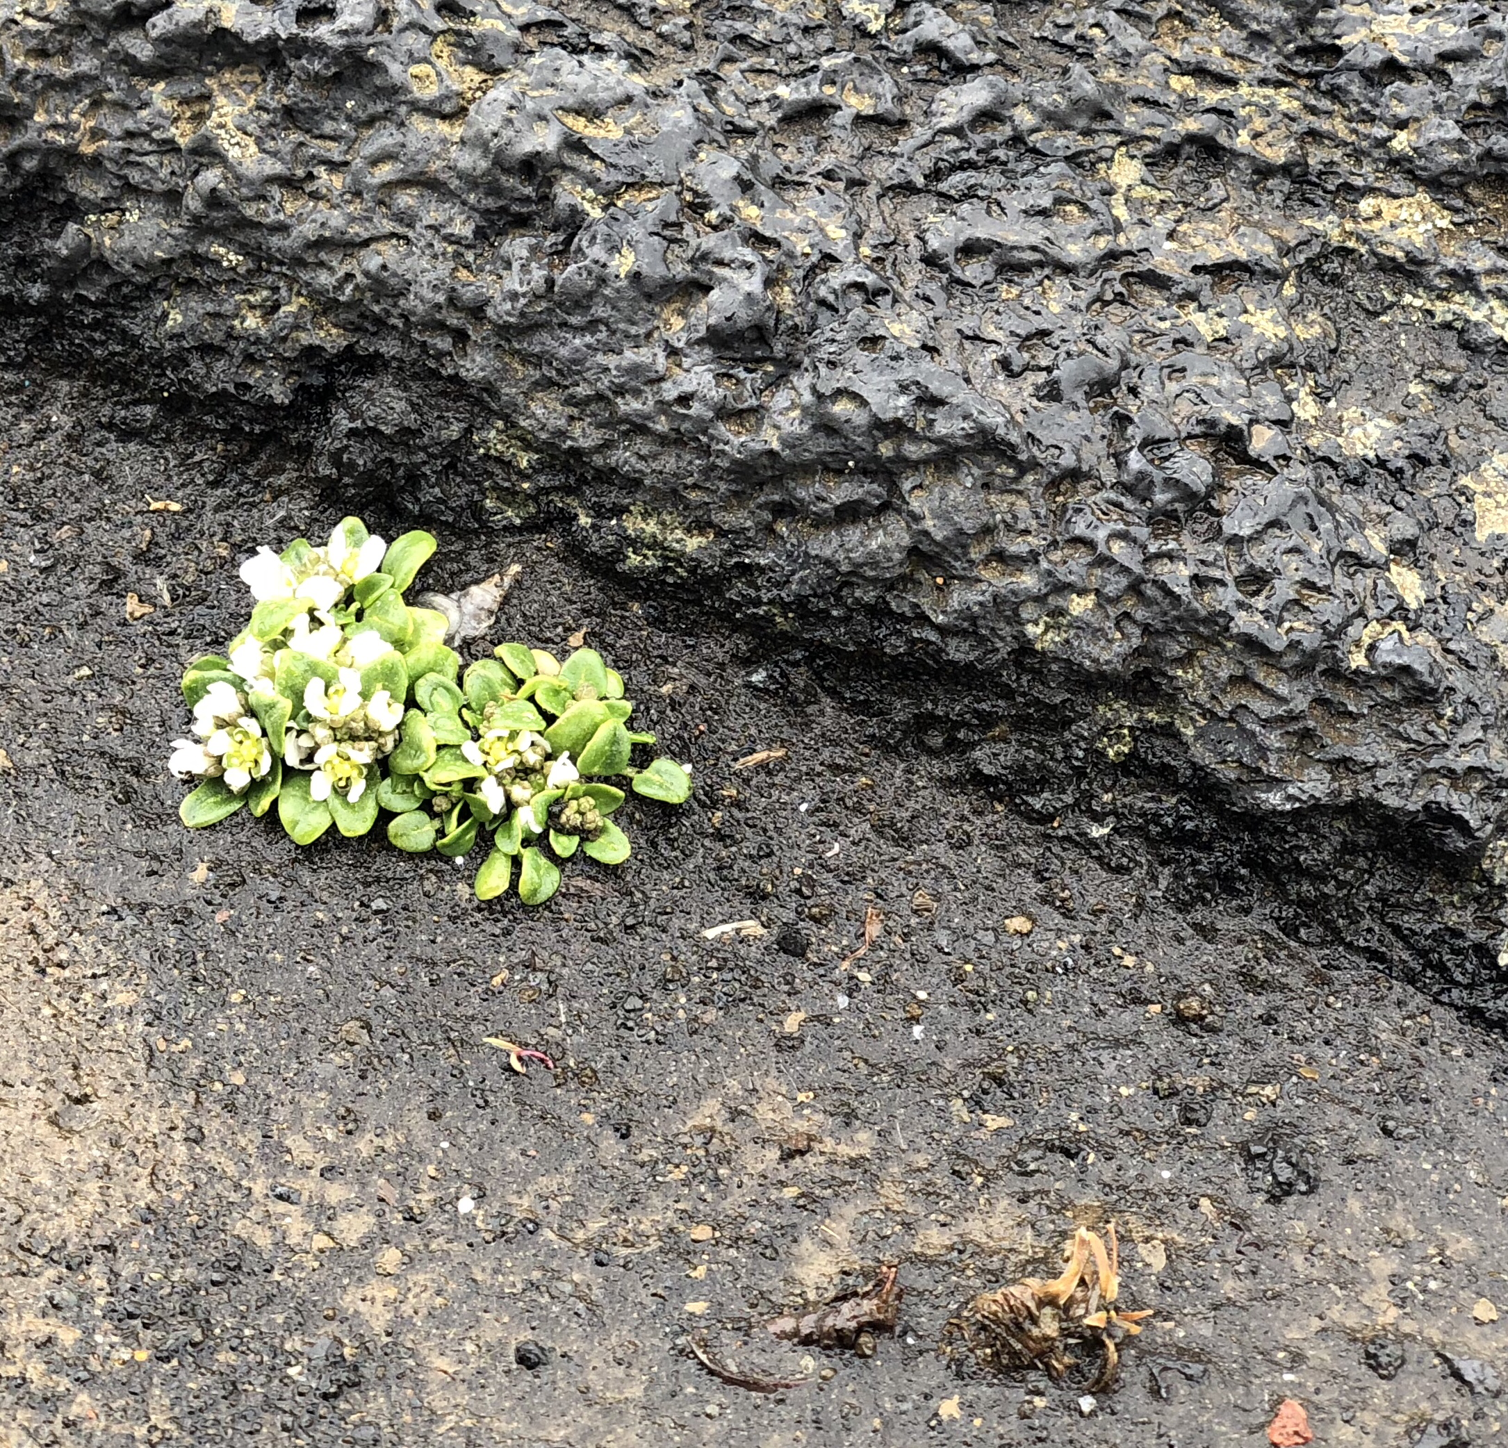
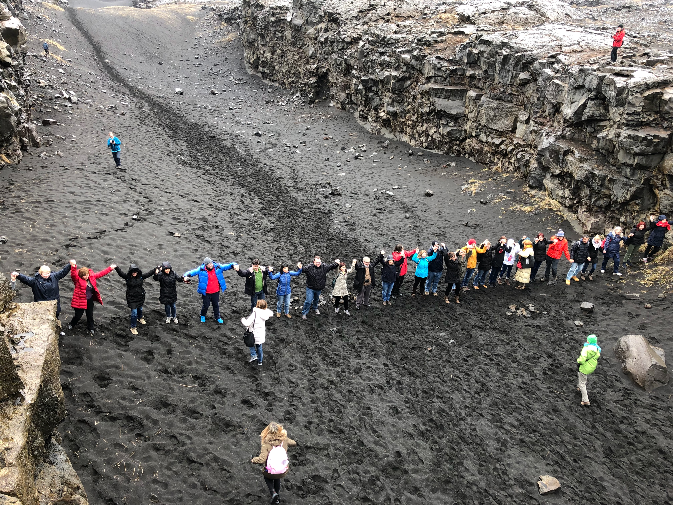
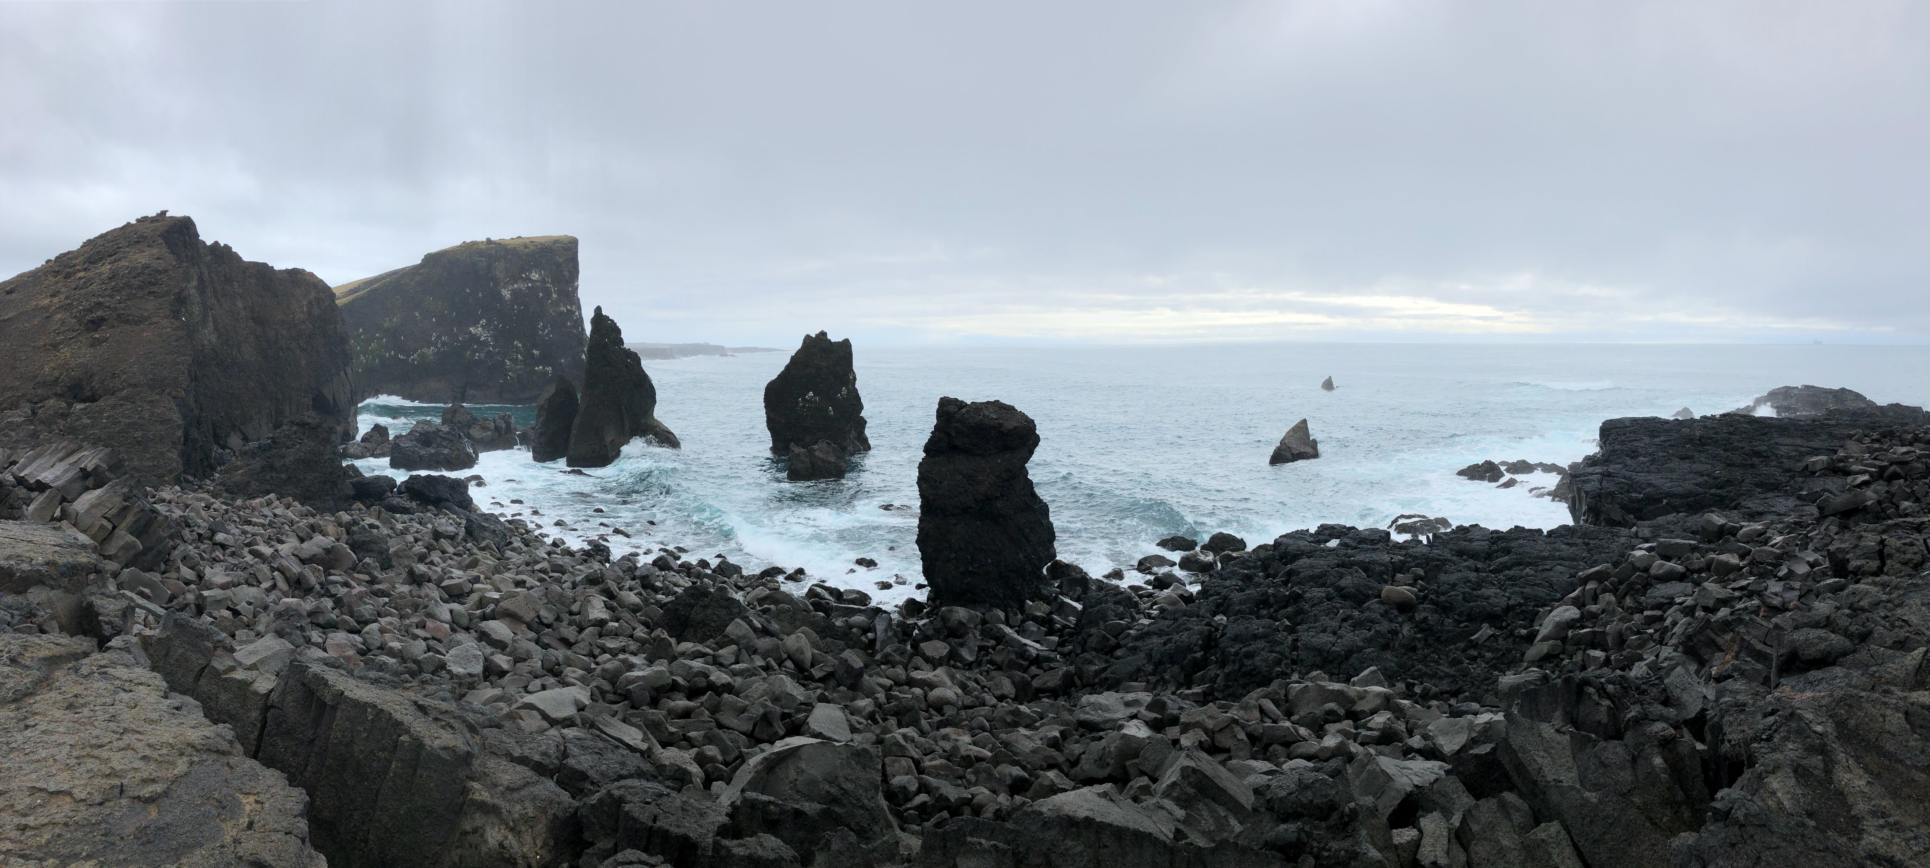
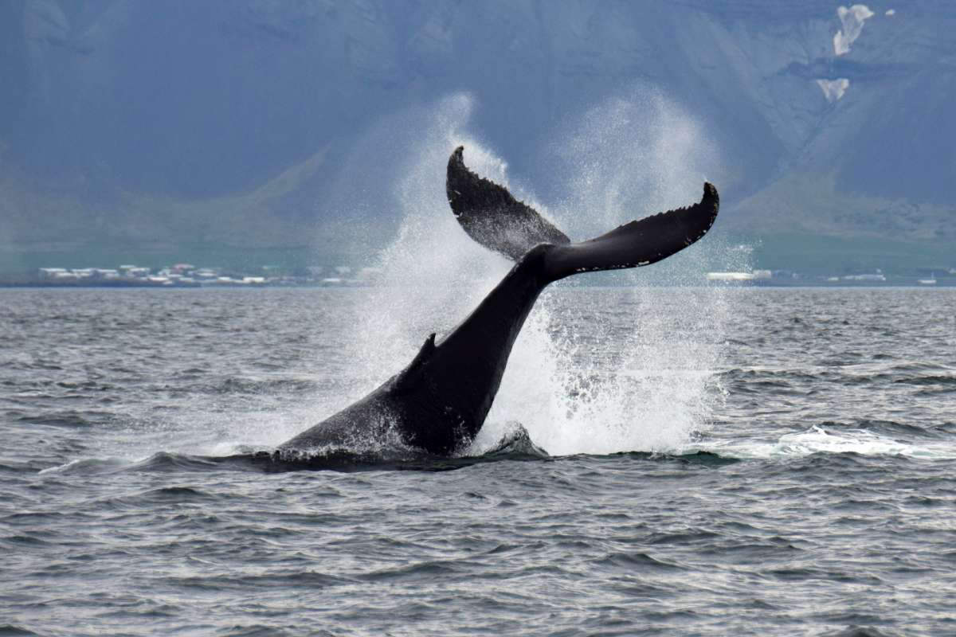
THE MOST REPRESENTATIVE PICTURES OF YOUR EXPERIENCE
NATURE

Slide 5
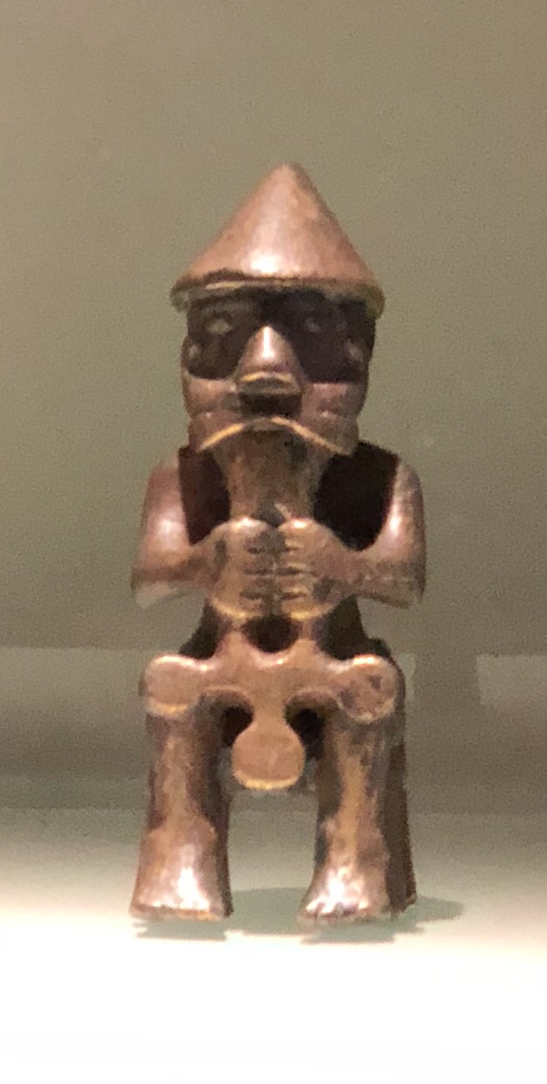
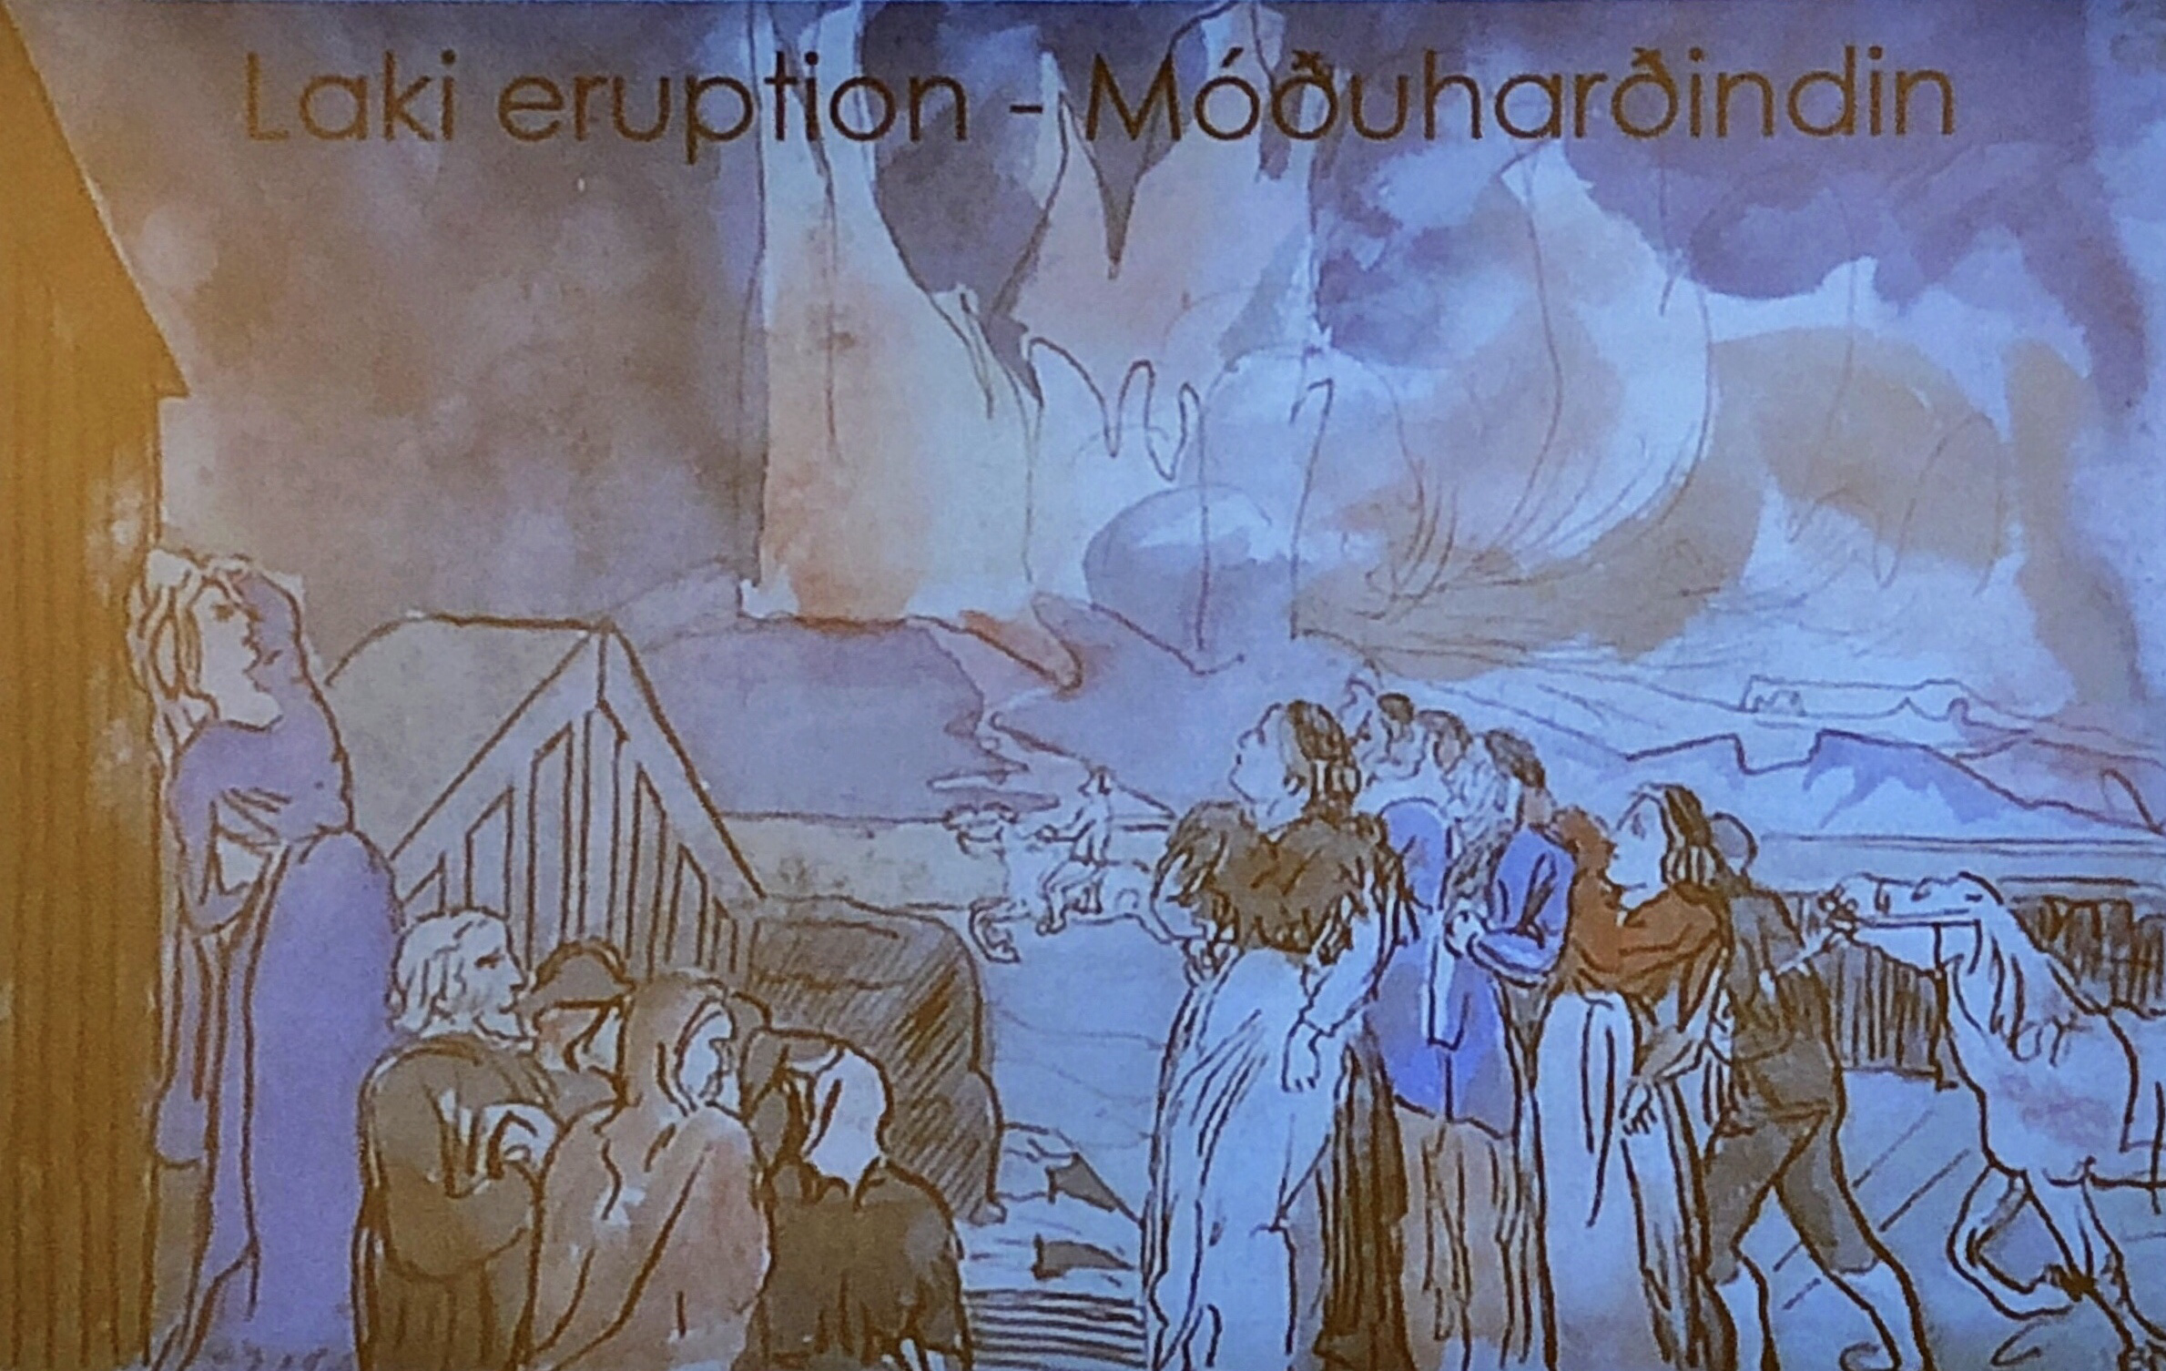
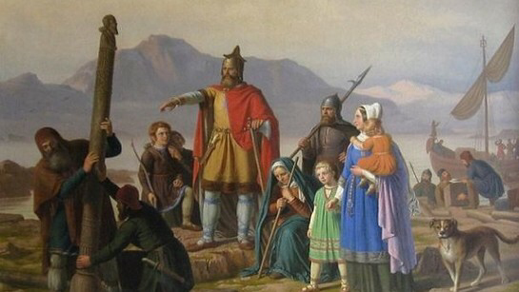
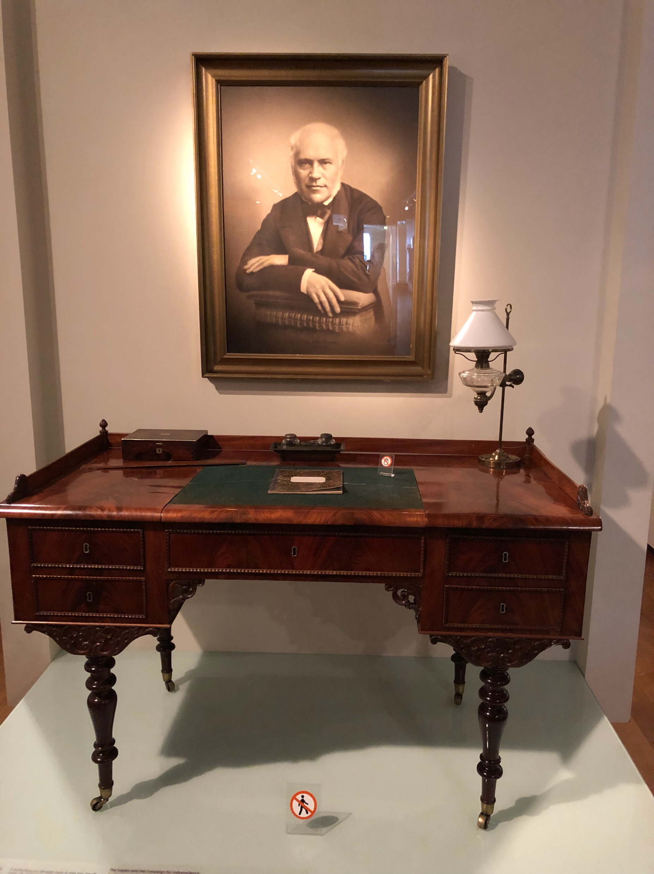
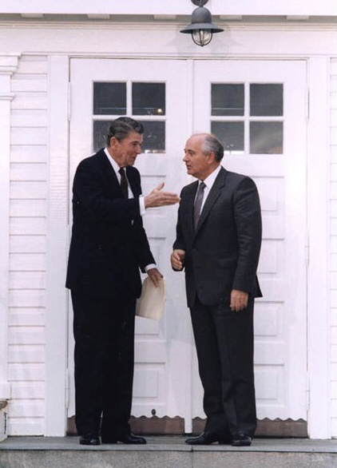
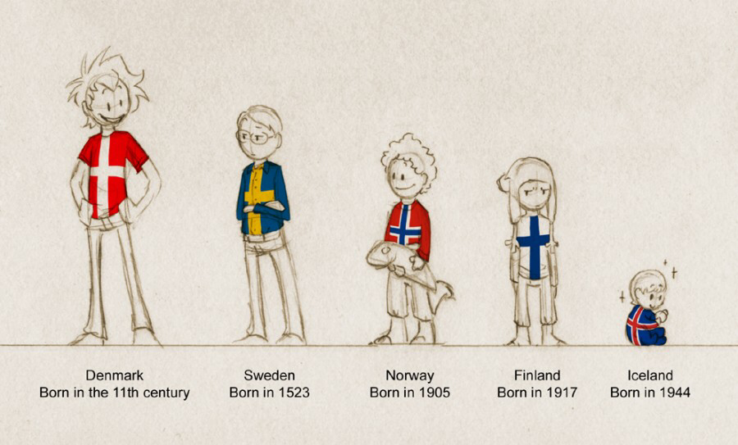
THE MOST REPRESENTATIVE PICTURES OF YOUR EXPERIENCE
HISTORY

Slide 6
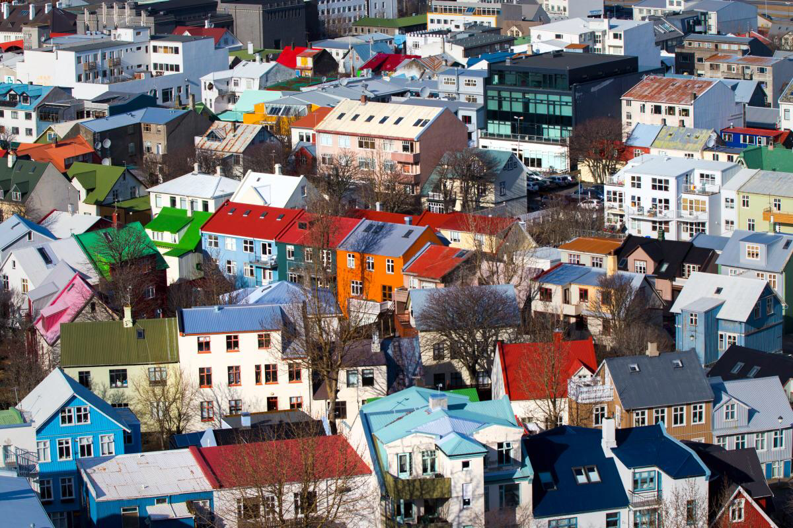
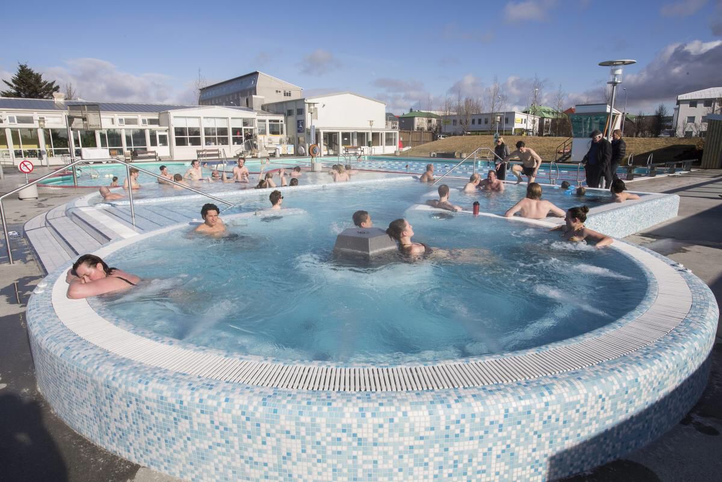
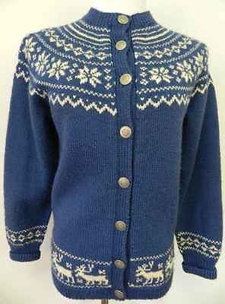
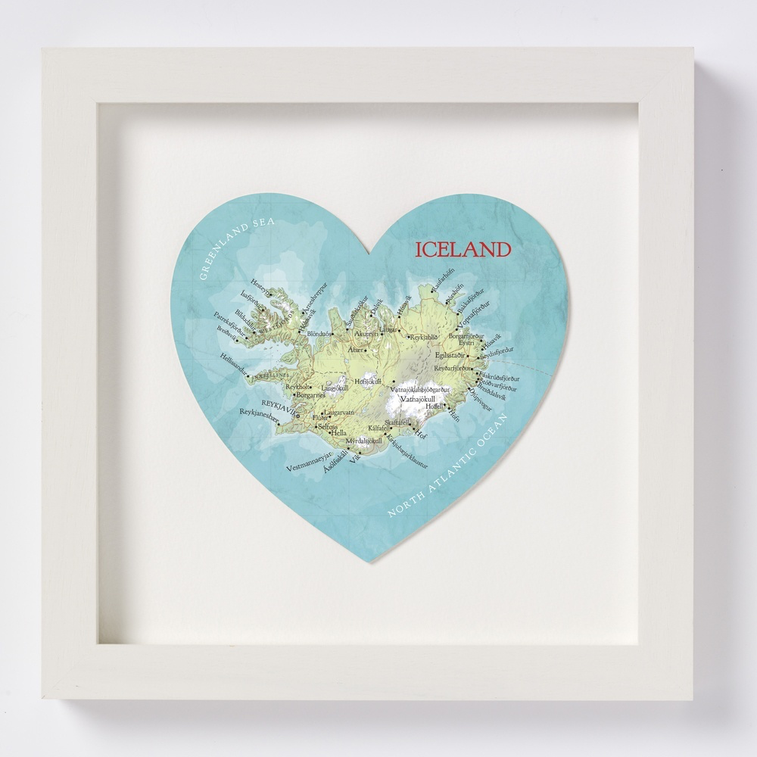
THE MOST REPRESENTATIVE PICTURES OF YOUR EXPERIENCE
LIFE IN ICELAND

Slide 7
Learning about schools & Education System, Dissemination of learning (for students)
Goal: motivate students and increase familiarity with Iceland.
Task: Students will prepare a brief presentation focusing on Nature, History and Life in Iceland.
Activities:
Teacher shows a brief motivating video about Iceland (from his/her stay)
Students are divided into three groups, each group working on one of the topics mentioned above.
Students will be provided with some material handed out by the teacher and they will also have to do some research.
Students present their work to the class.
Students solve a quiz with questions prepared in advance by the teacher.

Slide 8
Learning about schools & Education System, Dissemination of learning (for teachers, colleagues, public)
Teachers, colleagues
Interactive workshop
Public
Conference for municipality, school partners, local institutions, partner schools, parents association
School website facebook, twitter, instagram
Newsletter
Media
Local newspaper, radio, TV
Students magazine
THANK YOU VERY MUCH ENGLISH MATTERS

